Slide 1
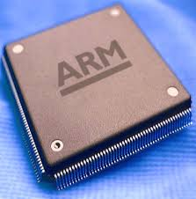
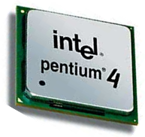
Microprocessors & Computer Architecture
UE18CS253
Unit-1 Session - 2
Credits:
MPCA Team
SESSION JAN-MAY 2020
SESSION JAN-MAY 2020
1
Notes:
1

Slide 2
Processor design trade-offs
What does the processor do?
Misconception - computers spend their time computing, i.e., carrying out arithmetic operations on user data.
Although they do a fair amount of arithmetic, most of this is with addresses in order to locate the relevant data items and program routines.
Then, having found the user's data, most of the work is in moving it around rather than processing it in any transformational sense.
Consider a Scenario : The programmer generally wants to express his or her program in as abstract a way as possible, using a high-level language which supports ways of handling concepts that are appropriate to the problem.
Modern trends towards functional and object-oriented languages move the level of abstraction higher.
The semantic gap between a high-level language construct and a machine instruction is bridged by a compiler ( A computer program that translates a high-level language program into a sequence of machine instructions).
Hence, the processor designer should define a good instruction set.
SESSION JAN-MAY 2020
SESSION JAN-MAY 2020
2
Notes:
2

Slide 3
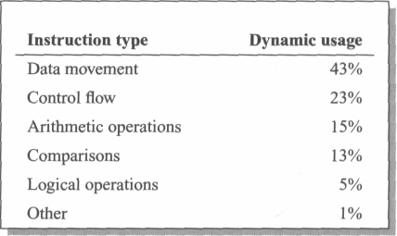
Processor design trade-offs
A typical set of statistics is shown below were gathered running a print preview program on an ARM instruction emulator, but are broadly typical of what may be expected from other programs and instruction sets.
Instructions to optimize are those concerned with data movement, either between the processor registers and memory or from register to register.
Secondly, the control flow instructions such as branches and procedure calls.
Arithmetic operations are down at 15%, as are comparisons at 13%.
SESSION JAN-MAY 2020
SESSION JAN-MAY 2020
3
Notes:
3

Slide 4
Processor design trade-off
Now, that it is clear what processors spend their time doing, is there a way to make the processor work faster ?
The most important of these is pipelining.
A very effective way of exploiting concurrency in a general-purpose processor.
Another important technique is the use of a cache memory.
A CPU cache is a cache used by the CPU to reduce the average time to access data from the main memory.
A third technique, super-scalar instruction execution.
A superscalar processor executes more than one instruction during a clock cycle by simultaneously dispatching multiple instructions to different execution units on the processor.
SESSION JAN-MAY 2020
SESSION JAN-MAY 2020
4
Notes:
4

Slide 5
R I S C
Reduced Instruction Set Computer
SESSION JAN-MAY 2020
SESSION JAN-MAY 2020
5

Slide 6


RISC – Reduced Instruction Set Computer
John Cocke - (May 30, 1925 – July 16, 2002), was an
American computer scientist recognized for his large contribution on computer architecture and optimizing compiler design. Originated the RISC concept in 1974.
Considered by many to be "the father of RISC architecture.” Proved that about 20% of the instructions in a computer did 80% of the work.
The term RISC is credited to David Patterson, a teacher at the University of California in Berkeley. The concept was used in Sun Microsystems' SPARC microprocessors and led to the founding of what is now MIPS Technologies, part of Silicon Graphics.
A number of current microchips now use the RISC concept.
SESSION JAN-MAY 2020
SESSION JAN-MAY 2020
6

Slide 7
RISC: Reduced Instruction Set Computer
Architecture
A fixed (32-bit).
A load-store architecture where instructions that process data, operate only on registers and are separate from instructions that access memory.
A large register bank (thirty-two 32-bit registers).
Instruction size with few formats.
RISC Organization
Hard-wired instruction decode logic (design of the control unit).
Pipelined execution.
Single-cycle execution.
RISC Advantages
A smaller die size.
A shorter development time.
A higher performance.
RISC Drawbacks
Poor code density.
Do not execute x86 code.
SESSION JAN-MAY 2020
7
Notes:
7

Slide 8
C I S C
Complex Instruction Set Computer
SESSION JAN-MAY 2020
SESSION JAN-MAY 2020
8

Slide 9
CISC – Complex Instruction Set Computer
Preamble
Earliest machines were programmed in assembly language and memory was slow and expensive.
The CISC philosophy made sense, and was commonly implemented in such large computers as the PDP-11 and the DEC system 10 and 20 machines.
Most common microprocessor designs such as the Intel 80x86 and Motorola 68K series followed the CISC philosophy.
But recent changes in software and hardware technology have forced a reexamination of CISC and many modern CISC processors are hybrids, implementing many RISC principles and vive versa.
CISC was developed to make compiler development simpler. It shifts most of the burden of generating machine instructions to the processor.
SESSION JAN-MAY 2020
9

Slide 10
CISC – Complex Instruction Set Computer
Architecture
CISC processors typically had variable length instruction sets with many formats.
Typically allowed values in memory to be used as operands in data processing instructions.
A 2-operand instruction format
Register sets were getting larger, but none was as large as RISC and most processors had different registers for different purposes.
CISC Organization
Micro-programmed control instruction decode logic.
It was easier to implement and less expensive.
CISC processors allowed little, if any, overlap between consecutive instructions.
The ease of microcoding new instructions allowed designers to make CISC machines upwardly compatible
May take many clock cycles to complete a single instruction.
Microprogram instruction sets can be written to match the constructs of high-level languages, the compiler does not have to be complicated.
Pentium is considered a modern CISC processor.
SESSION JAN-MAY 2020
10

Slide 11
CISC and RISC Convergence
State of the art processor technology has changed significantly since RISC chips were first introduced in the early '80s.
A number of advancements are used by both RISC and CISC processors.
The lines between the two architectures have begun to blur.
In fact, the two architectures almost seem to have adopted the strategies of the other.
Since, the processor speeds have increased, CISC chips are now able to execute more than one instruction within a single clock.
This also allows CISC chips to make use of pipelining.
With other technological improvements, it is now possible to fit many more transistors on a single chip.
SESSION JAN-MAY 2020
11

Slide 12
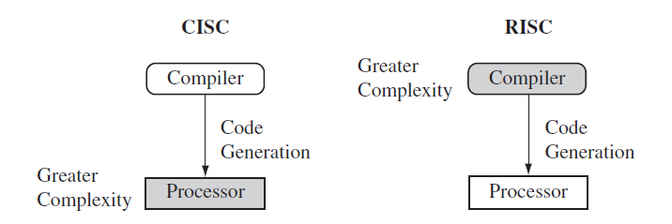
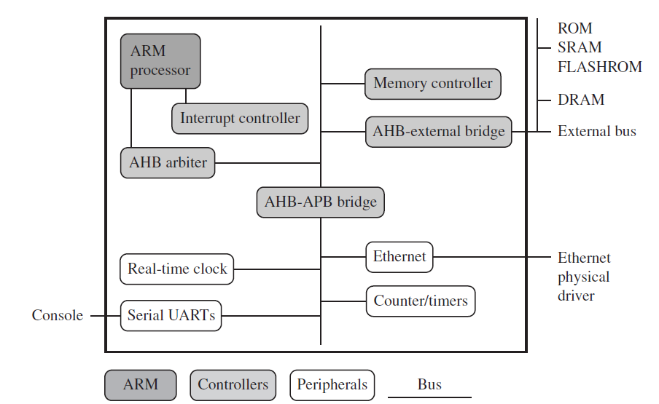
RISC vs CISC
CISC emphasizes hardware complexity.
RISC emphasizes Compiler complexity.
An ARM based embedded device, A Microcontroller
SESSION JAN-MAY 2020
SESSION JAN-MAY 2020
12

Slide 13
The ARM Architecture
The ARM [Acorn Risc Machine] is a RISC processor.
The RISC features incorporated by ARM.
A load-store architecture.
Fixed-length 32-bit instructions.
3-address instruction formats.
The RISC Features rejected by ARM.
Register windows.
RISC processors incorporated a large number of registers.
Procedure entry and exit instructions moved the visible 'window' to give each procedure access to new registers.
Thereby reducing the data traffic between the processor and memory resulting from register saving and restoring.
The principal problem with register windows is the large chip area occupied by the large number of registers.
This feature was therefore rejected on cost grounds.
SESSION JAN-MAY 2020
SESSION JAN-MAY 2020
13

Slide 14
The ARM Architecture
Delayed branches.
Branches cause pipelines problems since they interrupt the smooth flow of instructions.
RISC processors ameliorate the problem by using delayed branches where the branch takes effect after the following instruction has executed.
Work well on single issue pipelined processors But, do not scale well to super-scalar implementations & can interact badly with branch prediction mechanisms.
Single-cycle execution of all instructions.
ARM executes most data processing instructions in a single clock cycle, many other instructions take multiple clock cycles.
A simple load or store instruction requires at least two memory accesses.
Single cycle operation of all instructions is only possible with separate data and instruction memories.
SESSION JAN-MAY 2020
SESSION JAN-MAY 2020
14
Notes:
14

Slide 15
The ARM
programmer's model
SESSION JAN-MAY 2020
15

Slide 16
The ARM Architecture Versions
Version 1: 26 bit addressing, no coprocessor.
Version 2: Includes a 32 bit result multiply coprocessor
Version 3: 32 bit addressing
Version 4: Half word load/store instructions were provided.
Version 4T: Thumbing: 16 bit instructions can be compressed in a 32 bit processor, thus enabling more instructions to be packed in the same memory, thereby increasing the code density.
Version 5T and 5TE: 5TE: thumb extension- built for powerful computations.
SESSION JAN-MAY 2020
16

Slide 17
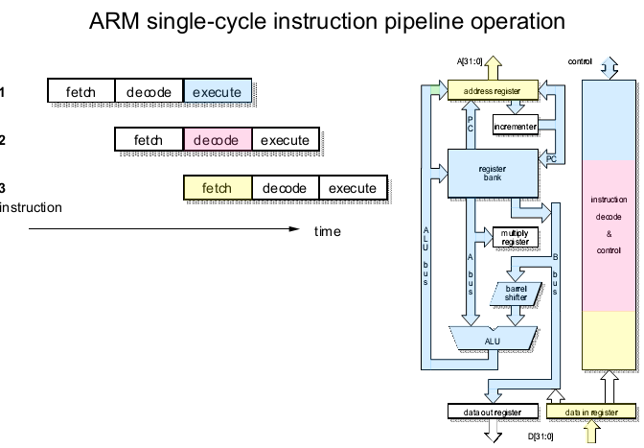
ARM Processor – 3 stage Pipeline Architecture
SESSION JAN-MAY 2020
17

Slide 18
Organization of ARM – 3 stage PP
The register bank, which stores the processor state.
Two read ports and One write port - to access any register
Plus an additional read port and an additional write port that give special access to r15
The barrel shifter, which can shift or rotate one operand by any number of bits.
The ALU, which performs the arithmetic and logic functions required by the instruction set.
The address register and incremented, which select and hold all memory addresses and generate sequential addresses when required.
The data registers, which hold data passing to and from memory.
The instruction decoder and associated control logic.
SESSION JAN-MAY 2020
18

Slide 19
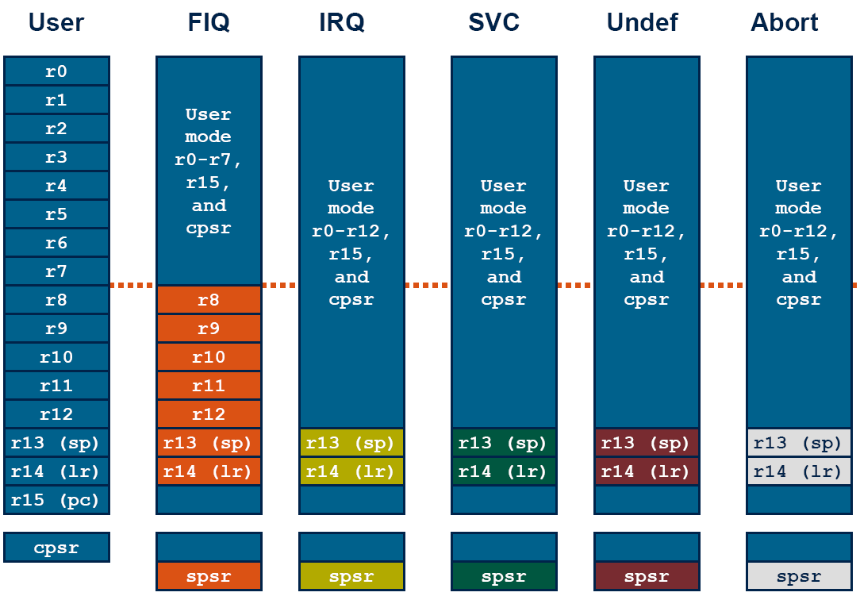
Register organization & Modes
SESSION JAN-MAY 2020
19
Notes:
19

Slide 20
REGISTER BANK
Register file of ARM, contains 37 registers in total. 20 registers are hidden in the user mode. These registers are accessible and viewed at different times.
These registers are called BANKED REGISTER.
Banked registers are available when the processor is in one of the privileged modes.
The processor has a set of associated bank registers in each mode.
When the register encounters any interrupt, and has to shift from the user mode, to any privileged mode, the register values have to pushed into the stack, and after the interrupt, is attended to, and the processor comes back to the user mode, it should pop the values from the stack. This causes SOFTWARE LATENCY.
But, since ARM has 20 banked registers, when the processor enters any of the privileged modes, these registers become visible, and some register values are copied onto the register bank, making available fresh copies.
This reduces the number of values that have to be popped and pushed onto the stack, thereby reducing software latency.
When the processor enters the privileged mode, the CPSR (Current Status Program Register) contents are copied onto the SPSR (Saved Status Program Register) register. There are 5 SPSR registers for the different privileged modes.
SESSION JAN-MAY 2020
20

Slide 21
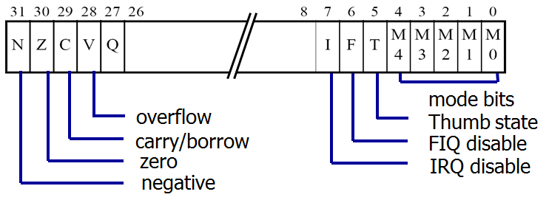
Current Program status register (CPSR)
N: Negative: the last ALU operation which changed the flags produced a negative result (the top bit of the 32-bit result was a one).
• Z: Zero: the last ALU operation which changed the flags produced a zero result (every bit of the 32-bit result was zero).
• C: Carry: the last ALU operation which changed the flags generated a carry-out, either as a result of an arithmetic operation in the ALU or from the shifter.
• V: Overflow: the last arithmetic ALU operation which changed the flags generated an overflow into the sign bit.
SESSION JAN-MAY 2020
21

Slide 22
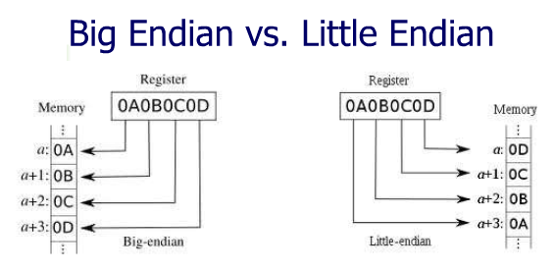
The Memory System
ARM processor supports both little endian & big endian methods for storing data in memory.
ARM processors support six data types.
• 8-bit signed and unsigned bytes.
• 16-bit signed and unsigned half-words; these are aligned on 2-byte boundaries.
• 32-bit signed and unsigned words; these are aligned on 4-byte boundaries.
SESSION JAN-MAY 2020
22

Slide 23
ARM Instruction Set - Features
All ARM instructions are 32 bits wide.
The load-store architecture.
3-Address data processing instructions (that is, the two source operand registers and the result register are all independently specified).
Conditional execution of every instruction.
Inclusion of very powerful load and store multiple register instructions.
Ability to perform a general shift operation and a general ALU operation in a single instruction that executes in a single clock cycle.
SESSION JAN-MAY 2020
23

Slide 24
Load-store architecture
The instruction set will only process [ADD, SUB] values which are in registers [Immediate data] and will always place the results of such processing into a register.
LOAD instructions operations which apply to memory state are ones which copy memory values into registers.
STORE instructions copy register values into memory.
ARM does not support 'memory-to-memory' operations.
ARM instructions fall into one of the following 3 categories.
Data processing instructions.
Ex: MOV, ADD, SUB, CMP, etc.,
Data transfer instructions.
Ex: LDR, STR
Control flow instructions
Ex: B, BGT, BEQ, BL, etc.,
SESSION JAN-MAY 2020
24

Slide 25
Q & A
SESSION JAN-MAY 2020
25

